Slide 1


Testing and integration
Requirement tracing

Slide 2

Definition of Testing
S/W testing is process, to evaluate the functionality of a software application with an intent to find if the developed S/W meet the requirements or not
It is defined as an execution of a work product with intent to find defects
Testing is done to protect the common users from any failure of system during usage.
The process can include:
Verifying S/W completeness in regards to functional/business requirements
Identifying technical bugs/errors and ensuring the software is error free
Assessing usability, performance, security, localization, compatibility and installation

Slide 3
Fundamental Test Process
Test Planning and Control
Test Analysis and Design
Test Implementation and Execution
Evaluating Exit Criteria and Reporting
Test Closure Activities

Slide 4

The Psychology of Testing
Comparison of the mindset of the tester and developer
The balance between self-testing and independent Testing
There should be clear and courteous communication and feedback on defects between tester and developer

Slide 5
Testing Approaches
1. Bing bang approach
It involves testing S/W after completion of development
It also called ‘Final Testing’ or ‘System Testing’
It is done before releasing S/W
Bing bang approach has main trust on black box testing of S/W to ensure that the requirements as defined and documented in requirement and design specifications are met successfully.
In Bing bang approach, S/W is tested before delivery
It not possible to detect all faults due to time constraints

Slide 6
Testing Approaches Cont.
2. Total Quality Management Approach
TQM can be defined as management technique for improving processes, products and services
It focuses on the entire business and NOT just on particular process
Defect removal costs are approximately 10 times more after coding
This is a cost associated with fixing the problems belonging to requirements, design, coding etc.

Slide 7
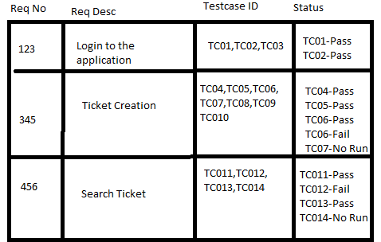
Requirement Traceability Matrix(RTM)
RTM is used to trace the requirements to the tests the are needed to verify whether the requirements are fulfilled
The purpose of the RTM is to ensure that all requirements defined for a system are tested.
The RTM is usually developed in concurrency with the initial list of requirements.
Types of RTM:
Forward Traceability(Mapping requirements to the test cases)
Backward or Reverse Traceability(Mapping test cases to requirements)

Slide 8
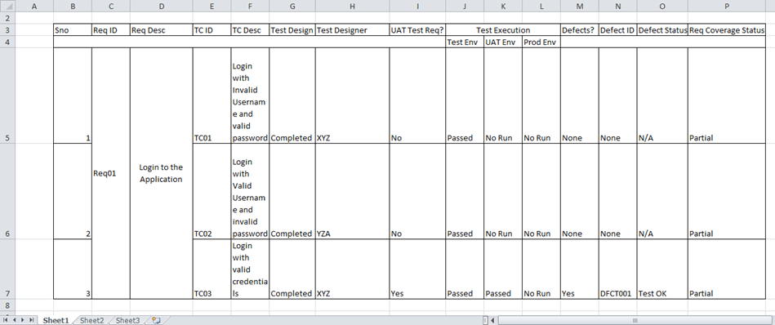
Requirement Traceability Matrix(RTM) cont.

Slide 9
Advantages of RTM
Entire S/W development can be tracked completely through RTM
Any test case failure can be tracked through requirements, designs, coding etc.
Any changes in requirements can be affected through entire work product upto test cases
Application becomes maintainable
Its also helps to understand if any redundancy has been created in the application
It may answer questions about what is being developed

Slide 10
Problems with RTM
Number of requirements are huge
Connectivity with different relationship
Requirements changes frequently and so do designs, code and test cases
A customer may not find value in it and pay for it
Incremental and iterative developments are the major challenges for maintaining traceability

Slide 11
Essentials of Software Testing
Test Strategy
Strengths
Weaknesses
Testing Plan
Test cases
Opportunities
Test data
Threats
Test Environment

Slide 12
Workbench
A workbench concept is a method of scheduling that how a particular action has to be executed. Actions contain in workbench are:
Input
Execute
Check
Production Output
Rework

Slide 13


Important Features of Testing Process
Easy to operate
Stability
Observability
Easy to understand
Decomposability

Slide 14
Misconceptions about Testing
Anyone can test
Testing can happen at the end
Testing can find all bugs
Defects found by customers are blamed on Tester
Test automation will replace manual testers.

Slide 15
Principles of Software Testing
Testing shows presence of defects
Exhaustive testing is not possible
Early Testing
Defect Clustering
Pesticide Paradox
Testing is context dependent
Absence of errors fallacy

Slide 16
Salient features of Good Testing
Capturing user requirements
Be Sceptical
Don’t compromise on quality
Design objectives
Ensure end user satisfaction
Think from the users perspective
Never Promise 100% coverage
Start early
Be open Suggestions

Slide 17
Test Policy
It is a document described at the organization level
It is determined by the senior management of the organization
The test policy is very high-level document and at the top of the test documentation structure
Organizations may prefer to publish their test policy in a sentence as well as a separate document
Policy can be used in both development and maintenance project

Slide 18
Test Policy shall describe the followings
Clear answer to the questions
It is determined by the senior management of the organisation.
The definition of the testing process used by the organization to increase the quality of the software developed
How the organization will measure the effectiveness and efficiency of the test while achieving goals.
How the organization will improve its test processes

Slide 19
Test Strategy
It is prepared at the program level and includes general test strategy, management principles, processes and approaches
It is also a high level document and is usually written by the test manager
It is generally prepared by the large scale projects in small scale projects, test strategies and test approach may be included in the test plan

Slide 20
Test Strategy includes:
Objectives/ Scope of testing
In-scope and Out-scope
Test Levels
Test types(Function/non-functional)
Entry/Exit
Risk
Test environment
Retesting & Regression approach

Slide 21
Test Planning
All test strategies specific to the project
Test estimations and test schedule
Test organization/roles/responsibilities
Test deliverables
Test reporting principles

Slide 22
Testing Process
Testing is a process rather than a single activity
Test processes are a vital part of SDLC
From planning to execution, each stage of the process is systematically planned
This can be combined and evaluated to get expected results and outcomes
The quality and effectiveness of the S/W testing is primarily determined by the quality of the test process

Slide 23
Test Team Efficiency
It is a very important aspect for development team and management
If team is very efficient, less iterations of testing are required
Every test manager must be aware of the efficiency of his team
Test team efficiency is depend on organizational culture

Slide 24
Mutation Testing
It is used to check capability of test program and test cases to find defects
The mutations introduced to source code are designed to imitate common programming errors
A good unit test suite typically detects the program mutations and fails automatically
The changes in mutant program are kept extremely small, so it does not affect the overall objective of the program

Slide 25
Challenges in Testing
Complete testing is impossible
Setting the right process
Lack of communication
Lack of recourses
Test coverage

Slide 26
Test Team approach
Proactive communication
Role and responsibility of Team members
Program Manager
QA Lead
Test analysist
Test Engineer

Slide 27
Process Problems faced by Testing
Unstable Environment
Tools being force-fed
Lack of feedback loop
Preconceived notions
No documentation

Slide 28
Cost aspect of Testing
Prevention Cost
Appraisal Cost
Internal failure cost
External Failure Cost

Slide 29
Contents of Test Policy Document
Definition of Testing
Description of Test process
Test evaluation
Quality Level to be achieved
Approach to Test process improvement

Slide 30
Errors
Errors can be present in software due to following reasons
Programming Error
Unclear requirements
Changing requirements
Software complexity
Time Pressures
Poorly Documented Codes

Slide 31
Defects
Defects can be simply defined as a variance between expected and actual
Defects is an error found after the application goes into production
Defects can be divided as follows:
Wrong
Missing
Extra

Slide 32
Developing Test Strategy
A test strategy document is a high level document, developed by project manager
It is normally derived from the business requirement specification Document
It is not updated too often(Static Document)
Process:
Select & Rank test factors for given application
Identify system development phases and related test factors
Identify associated risks with each selected test factor in case if it is not achieved
Identify phases in which risks of not meeting a test factor need to be addressed

Slide 33
Developing Testing Methodologies(Plan)
Acquire and study test strategy
Determine the type of development project being executed
Determine the type of software system being made
Identify tactical risks related to development
Determine when testing must occur during life cycle
Steps to develop customised test strategy
Type of development methodology impact test plan decisions

Slide 34
Testing Process
Defining Test Policy
Defining Test strategy
Preparing Test Plan
Establishing Testing Objectives for be Achieved
Designing Test Scenarios and Test cases
Writing/ reviewing Test cases
Defining Test Data
Creation of test Bed
Executing Test Cases
Test results
Test Analysis
Performing Retesting
Root Cause analysis

Slide 35
Attitude Towards Testing
It starts from test policy and ends to test strategy definition
Cross-cultural Differences
Lack of proper communication
Developers may not accept the defects in first place
Conflict between developer and tester

Slide 36
Raising Management Awareness for Testing
Management should be made aware of the importance of testing a product because the funds required will be provided by them.
Without adequate funding for testing, software quality suffers.
Benefits of S/W testing are enormous
Quality
Satisfied Customer
Bringing Profit
User Experience
Business Optimisation

Slide 37
Skills Required by Tester
Understanding Business needs
Good communication skills
Concepts of Testing
Levels of Testing
Knowing what to prioritize
Continuous Learning
Techniques for validation and verification
Risk assessment and management
Developing Test plan
Execution of test plan

Slide 38
REFERENCES:
https://www.guru99.com/traceability-matrix.html
Web section – Software Engineering 10th edition (software-engineering-book.com)
Software Quality Assurance by Tech-Max Publication
Software Quality Assurance by SHETH Publication
Software Testing: Principles, Techniques and Tools by M. G. Limaye

